Slide 1




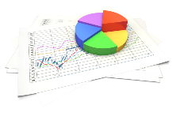
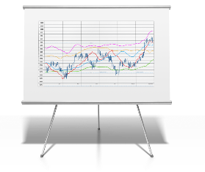
Quality Improvement Ecosystem
3. CLINICAL DECISION SUPPORT
1. RESEARCH, PAYER & PUBLIC HEALTH SURVEILLANCE
2. GUIDELINES
(Professional Societies, CDC, etc.)
MAKING it happen within local workflow.
What SHOULD happen. What do we want to happen?
What is ACTUALLY happening and why?
4. CLINICAL CARE
Clinician and Patient Workflow.
Patient, provider, population, public
6. REPORTING
5. MEASUREMENT ANALYTICS
Public Health
Quality
Safety
What DID happen? What processes and outcomes have been achieved?

Slide 2


Quality Improvement Ecosystem
EBM
CPG IG
3. CLINICAL DECISION SUPPORT
1. RESEARCH, PAYER & PUBLIC HEALTH SURVEILLANCE
2. GUIDELINES
(Professional Societies, CDC, etc.)
MAKING it happen within local workflow.
CDS Hooks
What SHOULD happen. What do we want to happen?
What is ACTUALLY happening and why?
4. CLINICAL CARE
CQL
QI Core
CR
Clinician and Patient Workflow.
Patient, provider, population, public
6. REPORTING
5. MEASUREMENT ANALYTICS
Public Health
Quality
Safety
What DID happen? What processes and outcomes have been achieved?
eCR
DEQM
QM IG

Slide 3
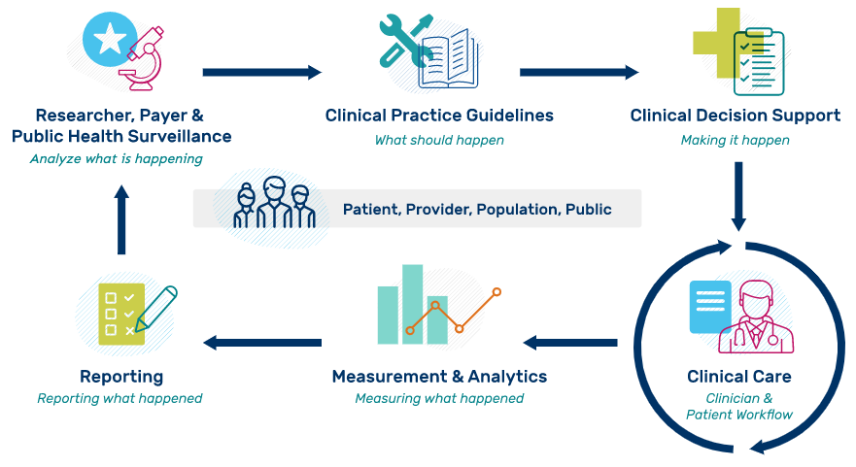
Quality Improvement Ecosystem
Notes:
The image highlights the ideal iterative flow of evidence-based information from research to clinical practice and measurement to evaluate clinical performance and outcomes for healthcare organizations. Please note that while it is depicted in a linear fashion, the process is often interactive between stakeholders and phases as well as iterative.

Slide 4
Quality Improvement Ecosystem
LEGEND: Sponsoring HL7 Workgroups
Clinical Decision Support (CDS)
Clinical Quality Information (CQI) Public Health (PH) Cross Group Projects (CGP)
EBM
CPG IG
US Core
CDS Hooks
CQL
QI Core
CR
US PH
MedMorph
eCR
DEQM
QM IG
Notes:
The image highlights the ideal iterative flow of evidence-based information from research to clinical practice and measurement to evaluate clinical performance and outcomes for healthcare organizations. Please note that while it is depicted in a linear fashion, the process is often interactive between stakeholders and phases as well as iterative.

Slide 5
Quality Improvement Ecosystem
LEGEND: Sponsoring HL7 Workgroups
Clinical Decision Support (CDS)
Clinical Quality Information (CQI) Public Health (PH) Cross Group Projects (CGP)
EBM
CPG IG
US Core
CDS Hooks
CQL
QI Core
CR
US PH
MedMorph
eCR
DEQM
QM IG
Notes:
The image highlights the ideal iterative flow of evidence-based information from research to clinical practice and measurement to evaluate clinical performance and outcomes for healthcare organizations. Please note that while it is depicted in a linear fashion, the process is often interactive between stakeholders and phases as well as iterative.

Slide 6
Quality Improvement Standards
Specification
Implementation
Model
Data Producers
Data Consumers
Providers
Patients
Care Givers
Clinical Systems
Patient Engagement
Healthcare Systems
Labs and Imaging
CDS Services
Aggregators
Clinical Registries
Public Health Agencies
Population Health
Interactions
Rules, Libraries, Measures
Guidance, Care Gaps, Reports
Logic
Authoring Guidance
Quality Agencies
Government Agencies
Industry Consortiums
Clinical Professional Societies
Model Guidance
Implementation Guidance
Specifiers

Slide 7

Quality Improvement Standards
Specification
Implementation
Model
Data Producers
Data Consumers
Providers
Patients
Care Givers
Clinical Systems
Patient Engagement
Healthcare Systems
Labs and Imaging
CDS Hooks
CDS Services
Aggregators
Clinical Registries
Public Health Agencies
Population Health
Interactions
Rules, Libraries, Measures
CQL
Guidance, Care Gaps, Reports
Logic
Authoring Guidance
Quality Agencies
Government Agencies
Industry Consortiums
Clinical Professional Societies
QM IG
Model Guidance
Implementation Guidance
Specifiers
DEQM
CPG IG
QI Core

Slide 8






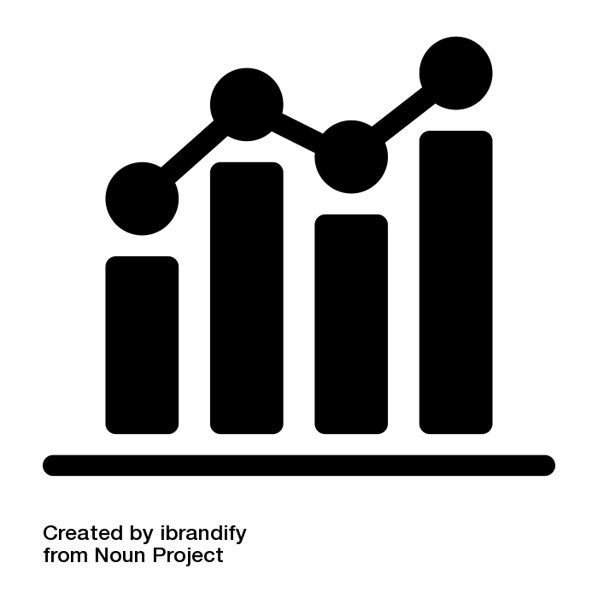








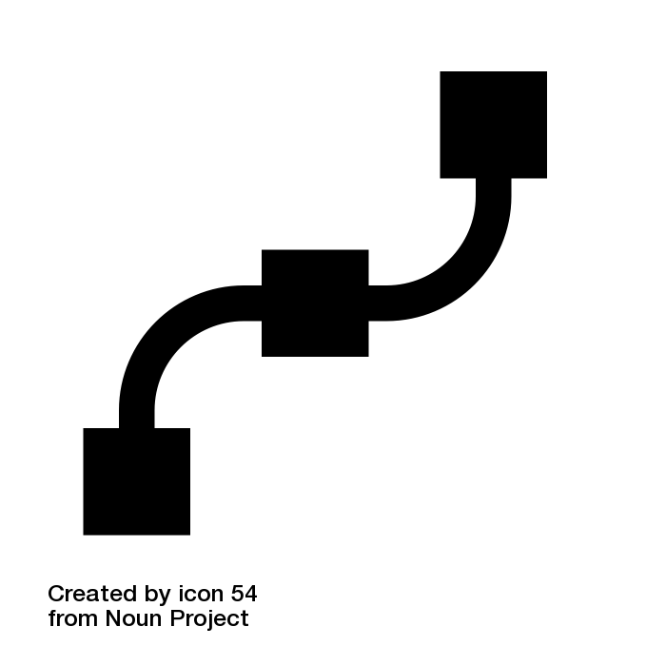



Content IGs
HEDIS
CDC Opioid Prescribing
WHO ANC
Model IGs
Specification IGs
IPS
US Core
QI Core
DEQM
QM
CPG-on-FHIR
EBM-on-FHIR
Foundation
Conformance
Administration
Clinical
Reasoning
FHIRPath
CQL
CDS Hooks
SMART
Notes:
FHIR-based Knowledge Representation Specifications
This diagram depicts 4 categories of specifications, with representative examples of each category, illustrating how the various pieces can be used together to deliver shareable clinical reasoning artifacts such as quality measures and decision support rules.
Along the bottom of the diagram are the foundational standards, including FHIR, with the 5 layers of Foundation, Conformance, Administration, Clinical, and Reasoning, as well as expression language and integration standards including FHIRPath, Clinical Quality Language, CDS Hooks, and SMART-on-FHIR.
In the middle left are the Model Implementation Guides, typically derived from Administration and Clinical resources such as Patient, Encounter, and MedicationRequest. Model IGs are typically built to address a broad range of use cases, focused on a particular target realm or domain.
In the middle right are the Specification Implementation Guides, which derive from the FHIR Clinical Reasoning resources to provide implementation guidance and conformance requirements for the creation, distribution, evaluation, and maintenance of shareable clinical knowledge. For example, the Quality Measure IG provides guidance on and conformance requirements for the use of the FHIR Measure and Library resources to create and share clinical quality measures, Data Exchange for Quality Measures (DEQM) provides guidance for reporting quality measures, and the Clinical Practice Guidelines IG (CPG-on-FHIR) demonstrates how to build shareable computable guideline content.
And finally, at the top of the diagram, the Content Implementation Guides are FHIR Implementation Guides, but not necessarily balloted as HL7 standards, rather these use the FHIR publication toolchain to support authoring and distribution, but the content is stewarded by separate authorities such as quality agencies and guideline developers; groups that have their own governance and maintenance policies. For example, the HEDIS IG contains HEDIS quality measures expressed using FHIR Measure and Library resources, and conforming to the Quality Measure IG profiles, while the CDC Opioid Prescribing IG and WHO Antenatal Care IGs contain decision support content to streamline guideline implementation. The content IGs conform to the specification IGs, and typically make use of the model IGs to define content focused on a particular realm.
The Foundation layer of FHIR defines the core data exchange protocol. The Conformance layer defines how resources, profiles, and terminologies are represented and used. The Administration layer defines individuals, locations, organizations, and encounters. The Clinical layer defines clinical information such as observations, medications, procedures, and orders. And the Reasoning layer provides definitional artifacts like plan and activity definitions, libraries, and measures.
FHIRPath is a simple, yet powerful, model-independent expression language that is used extensively throughout FHIR to describe paths to elements on resources, and define invariants on profiles.
CQL is a superset of FHIRPath that provides an author-friendly format for the description of clinical logic, as well as a machine-friendly format for processing the logic.
CDS Hooks is an HL7 standard specification for integrating decision support services with clinical systems. It is primarily focused on provide-facing remote decision support within an EMR.
SMART-on-FHIR is an HL7 standard specification for integrating clinical applications into EMRs using FHIR.
International Patient Summary (IPS) is a set of internationally applicable FHIR profiles used to share patient information across international boundaries. As a result, it forms an excellent foundation for expressing universally applicable content guidelines such as the WHO Antenatal Care (WHO ANC).
US Core is a set of profiles focused on enabling exchange of the US Clinical Data for Interoperability (US CDI), and is supported by a broad range of EMR vendors within the US.
QI Core is a set of profiles that derives from US Core to enable quality improvement use cases such as quality measurement and decision support within the US.

Slide 9

Content IGs
HEDIS
CDC Opioid Prescribing
WHO ANC
Model IGs
Specification IGs
IPS
US Core
QI Core
DEQM
QM
SDC
CPG-on-FHIR
EBM-on-FHIR
Foundation
Conformance
Administration
Clinical
Reasoning
FHIRPath
CQL
CDS Hooks
SMART
Notes:
FHIR-based Knowledge Representation Specifications
This diagram depicts 4 categories of specifications, with representative examples of each category, illustrating how the various pieces can be used together to deliver shareable clinical reasoning artifacts such as quality measures and decision support rules.
Along the bottom of the diagram are the foundational standards, including FHIR, with the 5 layers of Foundation, Conformance, Administration, Clinical, and Reasoning, as well as expression language and integration standards including FHIRPath, Clinical Quality Language, CDS Hooks, and SMART-on-FHIR.
In the middle left are the Model Implementation Guides, typically derived from Administration and Clinical resources such as Patient, Encounter, and MedicationRequest. Model IGs are typically built to address a broad range of use cases, focused on a particular target realm or domain.
In the middle right are the Specification Implementation Guides, which derive from the FHIR Clinical Reasoning resources to provide implementation guidance and conformance requirements for the creation, distribution, evaluation, and maintenance of shareable clinical knowledge. For example, the Quality Measure IG provides guidance on and conformance requirements for the use of the FHIR Measure and Library resources to create and share clinical quality measures, Data Exchange for Quality Measures (DEQM) provides guidance for reporting quality measures, and the Clinical Practice Guidelines IG (CPG-on-FHIR) demonstrates how to build shareable computable guideline content.
And finally, at the top of the diagram, the Content Implementation Guides are FHIR Implementation Guides, but not necessarily balloted as HL7 standards, rather these use the FHIR publication toolchain to support authoring and distribution, but the content is stewarded by separate authorities such as quality agencies and guideline developers; groups that have their own governance and maintenance policies. For example, the HEDIS IG contains HEDIS quality measures expressed using FHIR Measure and Library resources, and conforming to the Quality Measure IG profiles, while the CDC Opioid Prescribing IG and WHO Antenatal Care IGs contain decision support content to streamline guideline implementation. The content IGs conform to the specification IGs, and typically make use of the model IGs to define content focused on a particular realm.
The Foundation layer of FHIR defines the core data exchange protocol. The Conformance layer defines how resources, profiles, and terminologies are represented and used. The Administration layer defines individuals, locations, organizations, and encounters. The Clinical layer defines clinical information such as observations, medications, procedures, and orders. And the Reasoning layer provides definitional artifacts like plan and activity definitions, libraries, and measures.
FHIRPath is a simple, yet powerful, model-independent expression language that is used extensively throughout FHIR to describe paths to elements on resources, and define invariants on profiles.
CQL is a superset of FHIRPath that provides an author-friendly format for the description of clinical logic, as well as a machine-friendly format for processing the logic.
CDS Hooks is an HL7 standard specification for integrating decision support services with clinical systems. It is primarily focused on provide-facing remote decision support within an EMR.
SMART-on-FHIR is an HL7 standard specification for integrating clinical applications into EMRs using FHIR.
International Patient Summary (IPS) is a set of internationally applicable FHIR profiles used to share patient information across international boundaries. As a result, it forms an excellent foundation for expressing universally applicable content guidelines such as the WHO Antenatal Care (WHO ANC).
US Core is a set of profiles focused on enabling exchange of the US Clinical Data for Interoperability (US CDI), and is supported by a broad range of EMR vendors within the US.
QI Core is a set of profiles that derives from US Core to enable quality improvement use cases such as quality measurement and decision support within the US.

Slide 10

eCQM ProgramS
CDC Opioid Prescribing
WHO FP
WHO STI
WHO ANC
Content IGs
HEDIS
MME Calculation
WHO CORE
Model IGs
Specification IGs
IPS
US Core
QI Core
DEQM
QM
SDC
CPG-on-FHIR
EBM-on-FHIR
Foundation
Conformance
Administration
Clinical
Reasoning
FHIRPath
CQL
CDS Hooks
SMART
Notes:
FHIR-based Knowledge Representation Specifications
This diagram depicts 4 categories of specifications, with representative examples of each category, illustrating how the various pieces can be used together to deliver shareable clinical reasoning artifacts such as quality measures and decision support rules.
Along the bottom of the diagram are the foundational standards, including FHIR, with the 5 layers of Foundation, Conformance, Administration, Clinical, and Reasoning, as well as expression language and integration standards including FHIRPath, Clinical Quality Language, CDS Hooks, and SMART-on-FHIR.
In the middle left are the Model Implementation Guides, typically derived from Administration and Clinical resources such as Patient, Encounter, and MedicationRequest. Model IGs are typically built to address a broad range of use cases, focused on a particular target realm or domain.
In the middle right are the Specification Implementation Guides, which derive from the FHIR Clinical Reasoning resources to provide implementation guidance and conformance requirements for the creation, distribution, evaluation, and maintenance of shareable clinical knowledge. For example, the Quality Measure IG provides guidance on and conformance requirements for the use of the FHIR Measure and Library resources to create and share clinical quality measures, Data Exchange for Quality Measures (DEQM) provides guidance for reporting quality measures, and the Clinical Practice Guidelines IG (CPG-on-FHIR) demonstrates how to build shareable computable guideline content.
And finally, at the top of the diagram, the Content Implementation Guides are FHIR Implementation Guides, but not necessarily balloted as HL7 standards, rather these use the FHIR publication toolchain to support authoring and distribution, but the content is stewarded by separate authorities such as quality agencies and guideline developers; groups that have their own governance and maintenance policies. For example, the HEDIS IG contains HEDIS quality measures expressed using FHIR Measure and Library resources, and conforming to the Quality Measure IG profiles, while the CDC Opioid Prescribing IG and WHO Antenatal Care IGs contain decision support content to streamline guideline implementation. The content IGs conform to the specification IGs, and typically make use of the model IGs to define content focused on a particular realm.
The Foundation layer of FHIR defines the core data exchange protocol. The Conformance layer defines how resources, profiles, and terminologies are represented and used. The Administration layer defines individuals, locations, organizations, and encounters. The Clinical layer defines clinical information such as observations, medications, procedures, and orders. And the Reasoning layer provides definitional artifacts like plan and activity definitions, libraries, and measures.
FHIRPath is a simple, yet powerful, model-independent expression language that is used extensively throughout FHIR to describe paths to elements on resources, and define invariants on profiles.
CQL is a superset of FHIRPath that provides an author-friendly format for the description of clinical logic, as well as a machine-friendly format for processing the logic.
CDS Hooks is an HL7 standard specification for integrating decision support services with clinical systems. It is primarily focused on provide-facing remote decision support within an EMR.
SMART-on-FHIR is an HL7 standard specification for integrating clinical applications into EMRs using FHIR.
International Patient Summary (IPS) is a set of internationally applicable FHIR profiles used to share patient information across international boundaries. As a result, it forms an excellent foundation for expressing universally applicable content guidelines such as the WHO Antenatal Care (WHO ANC).
US Core is a set of profiles focused on enabling exchange of the US Clinical Data for Interoperability (US CDI), and is supported by a broad range of EMR vendors within the US.
QI Core is a set of profiles that derives from US Core to enable quality improvement use cases such as quality measurement and decision support within the US.

Slide 11
Data Model Standards Landscape
Use case focused
Content
Quality Improvement focused
QI Core
Constraint-based Definition
Consensus-based Promotion
US Realm specific profiles
US Core
Universally applicable resources and guidance
FHIR

Slide 12
Data Model Standards Landscape
CMS dQMs
HEDIS
Opioid CDS
ANC
FP
STI
CHF
Content
QI Core
ODH
SDOH
mCODE
HIV
Cancer
Domain
Constraint-based Definition
Consensus-based Promotion
US Core
IPS
AU Core
Realm
FHIR
FHIR

Slide 13

Repository stores
Content processing
Authors
& Stewards
eCQI Resource Center (website)
Value Set Authority Center (website)
eCQI Measure Repository
(Measure API)
CTS FHIR Service (Terminology API)
Implementers (Website Users, manual download)
Implementing Systems (API access, automated ingestion/processing)

Slide 15
EHR Environment
Authority/
Agency
Reporting
Specification
Reporting Application
Electronic Health Record
Analytics on
Reported Data
Data Repository
Reports

Slide 16
Measure Specifications
Authority/
Agency
Terminology
Specification
Report
Provider System
Receiving System

Slide 17
eCQI Resource Center
Measure Specifications
Authority/
Agency
CMS
VSAC
Terminology
Typically a pull interaction, download of a zip file
Specification
HQMF
VSAC formatted content, typically a pull interaction as a zip of Excel spreadsheets
QRDA
Report
Provider System
Receiving System
Vendor/Reporting Systems
Typically a push interaction, using file transfer technology

Slide 18
eCQI Resource Center
Measure Specifications
Authority/
Agency
CMS
VSAC
Terminology
Measure Repository
Specification
Measure
MeasureReport
Report
Measure Terminology Service
Provider System
Receiving System
Vendor/Reporting Systems
Measure Receiving Service

Slide 19
eCQI Resource Center
QM IG
Measure Specifications
Authority/
Agency
CMS
VSAC
Terminology
Measure Repository
Specification
Measure
MeasureReport
Report
Measure Terminology Service
Provider System
Receiving System
DEQM IG
Vendor/Reporting Systems
Measure Receiving Service

Slide 20
SEP
JAN
MAY
US Core | QI Core | QM IG | DEQM IG
3.1.1 | 4.1.1 | 4.0.0 | 4.0.0
6.1.0 | 6.0.0 | 5.0.0 | 5.0.0
7.0.0 | 7.0.0? | 6.0.0? | 6.0.0?
2023
2024
2025

Slide 21

DEQM IG
Mar
Apr
Feb
May
Annual Update
USCore
QM IG
Jan
Jun
Dec
Jul
Nov
Aug
Oct
Sep
QICore

Slide 22
CMS124 Manifest
CMS124
EP/EC
CMS125 Manifest
CMS125
CMS130 Manifest
CMS130
EH
CMS108 Manifest
CMS108
CMS109 Manifest
CMS109

Slide 23
Shareable
Computable
Publishable
Executable
CRMIShareableLibrary
CRMIComputableLibrary
CRMIPublishableLibrary
CRMIExecutableLibrary
CRMIShareableMeasure
CRMIPublishableMeasure
CQFMComputableMeasure
CQFMPublishableMeasure
CQFMExecutableMeasure
CQFMCohortMeasure
CQFMProportionMeasure
CQFMRatioMeasure
CQFMContinuousVariableMeasure
CQFMCompositeMeasure
CQLMeasure
ELMMeasure
CQLLibrary
ELMJSONLibrary
ELMXMLLibrary
CQLMeasure
ELMMeasure
All expression-valued elements SHALL use text/cql-identifier or text/cql-expression
Measure.library 0..1 CQLLibrary
All expression-valued elements SHALL use text/cql-identifier
Measure.library 1..1 ELMJSONLibrary | ELMXMLLibrary
CQFMComputableMeasure
CQFMExecutableMeasure
Measure.library 0..1 CRMIComputableLibrary
Measure.library 1..1 CRMIExecutableLibrary

